Slide 1
Structured Query Language
Advanced

Slide 2
Part 1 – Advanced Queries

Slide 3
Group By
The SQL GROUP BY statement is used along with the SQL aggregate functions like SUM to provide means of grouping the result dataset by certain database table column(s).

Slide 4
Simplest Example:
SELECT customer FROM orders GROUP BY customer;
Rita
Lucie
Neza
Marie Claire
NOTE : We could use DISTINCT to get the same result…So Why use GROUP BY???

Slide 5
The Power of GROUP BY
GROUP BY combined with aggregate functions
SELECT customer, SUM(quantity) AS "Total Items" FROM orders GROUP BY customer;
Rita 5
Lucie 7
Neza 3
Marie Claire 6

Slide 6
What About No GROUP BY???
SELECT customer,SUM(quantity) FROM orders
Rita 21
Lucie 21
Rita 21
Neza 21
Marie Claire 21
Neza 21
Neza 21
NOTE: Here we have the total sum of the quantity column

Slide 7
Another Example
SELECT customer, SUM((orders.quantity * inventory.price)) AS "COST" FROM orders JOIN inventory ON orders.product = inventory.product GROUP BY customer;
Notice the benefit of using a column alias
Also notice the math operations inside the sum

Slide 8
Multiple GROUP BY Example
SELECT day_of_order, product, SUM(quantity) as "Total" FROM orders GROUP BY day_of_order,product ORDER BY day_of_order;
day_of_order product Total
2008-07-25 00:00:00.000 19" LCD Screen 5
2008-07-25 00:00:00.000 HP Printer 4
2008-08-01 00:00:00.000 Hanging Files 11
2008-08-01 00:00:00.000 Stapler 3
2008-08-15 00:00:00.000 19" LCD Screen 5
2008-08-16 00:00:00.000 Hanging Files 14

Slide 9
HAVING
The SQL HAVING clause is like a WHERE clause for aggregated data.
Any column name appearing in the HAVING clause must also appear in the GROUP BY clause.

Slide 10
HAVING Example
SELECT day_of_order, product, SUM(quantity) as "Total" FROM orders GROUP BY day_of_order,product,quantity HAVING quantity > 7 ORDER BY day_of_order;
day_of_order product Total
2008-08-01 00:00:00.000 Hanging Files 11
2008-08-16 00:00:00.000 Hanging Files 14

Slide 11
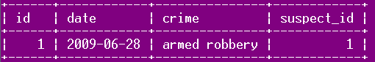
Subqueries
A query within another query. The "inner" query provides values for the criteria of the main query
Joins are usually more efficient than subqueries
Ex:
select * from crime where date in (select my_date from forecast_data);

Slide 12
Non-Correlated Subquery
This subquery is non-correlated because it can be run on its own
In MySQL, try to use joins instead of non-correlated subqueries
http://bugs.mysql.com/bug.php?id=9090
select crime from crime where date in (select my_date from forecast_data);
select c.crime from crime c, forecast_data f where c.date = f.my_date;

Slide 13
Correlated Subquery
A correlated subquery is a query nested inside another query that uses values from the outer query in its WHERE clause.
The sub-query is evaluated once for each row processed by the outer query.
NOTE: Department average salary must be calculated every time since each employee could be in a different department.
SELECT employee_number, name FROM employee AS e1 WHERE salary > (SELECT avg(salary) FROM employee WHERE department = e1.department);

Slide 14
Subqueries
Joins
They allow queries that are structured so that it is possible to isolate each part of a statement.
They provide alternative ways to perform operations that would otherwise require complex joins and unions.
They are, in many people's opinion, more readable than complex joins or unions.
In general, joins are faster. Many db optimizers convert subqueries into joins where possible.
Joins are advantageous over sub-queries if the SELECT query contains columns from more than one table.
For MySQL, it is especially true that you should use joins where possible because non-corralated subqueries are not optimized correctly.

Slide 15
Part 2 – DB Administration

Slide 16
CREATE TABLE
Creates a table and sets defaults to null except for the id field
CREATE TABLE forecast_data2 (
my_date date default NULL,
description varchar(50) default NULL,
details varchar(50) default NULL,
id int
);

Slide 17
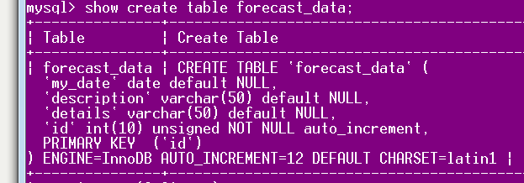
Create Table

Slide 18
Change the Name of a Column
alter table suspect
change column
id sid int not null auto_increment;
Old name
New name

Slide 19
ALTER
alter table x add column b int;
alter table x drop column b;
alter table x modify column a varchar(50);
alter table x modify column a a_new varchar(20);

Slide 20
Altering an Existing Column to Be a Primary Key
alter table suspect
modify column
id int not null auto_increment primary key;

Slide 21
Constraints
Restrict the type of data that can be entered into a table
Not Null
Unique
Primary Key
Foreign Key
Check
Default

Slide 22
UNIQUE
Guarantees Uniqueness
alter table forecast_data
add column
(idu int unique);

Slide 23
Primary Key
Constraint which serves as the identifier for each record in the table
Each table should only have one primary key (may be a composite key – check out this interesting article and read the comments!
http://weblogs.sqlteam.com/jeffs/archive/2007/08/23/composite_primary_keys.aspx)

Slide 24
Foreign Key
A foreign key refers to a primary key in another table
The constraint maintains "referential integrity".
This means it ensures the foreign key refers to a primary key that actually exists

Slide 25
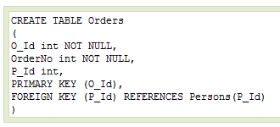
Foreign Key

Slide 26
CHECK
Ensure the value inserted into the table conforms to a condition specified by CHECK
alter table forecast_data
add
column (idu int check(idu>0));

Slide 27
AUTO_INCREMENT
Ensures that values for the column will automatically be incremented by one upon insert
alter table houses modify id int not null auto_increment;

Slide 28
Part 3 – DB Optimization
http://20bits.com/articles/10-tips-for-optimizing-mysql-queries-that-dont-suck/
http://dev.mysql.com/doc/refman/5.0/en/optimization.html
http://www.smart-soft.co.uk/Oracle/oracle-performance-tuning-part1.htm

Slide 29
References
http://dev.mysql.com/doc/
http://www.tizag.com/sqlTutorial/sqlgroupby.php
http://www.w3schools.com/sql/sql_groupby.asp
http://www.w3schools.com/sql/sql_having.asp
http://www.sql-tutorial.net/SQL-GROUP-BY.asp
http://www.sql-tutorial.net/SQL-HAVING.asp
Note: The official MySQL website is a great resource. Unlike many sites…yeah Tomcat…I’m looking at you…this website is very thorough and easy to understand. Even the search feature is well done!

